Slide 1
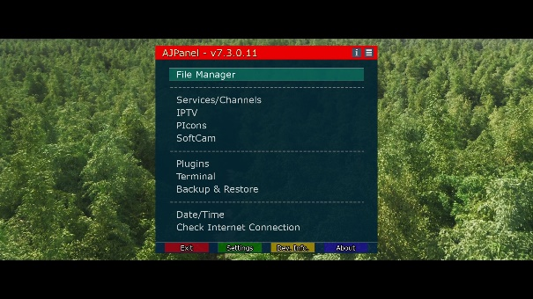

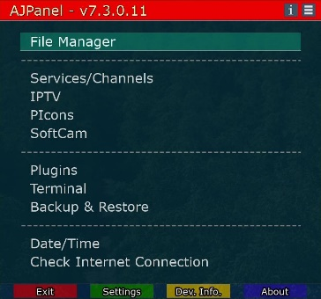
AJPanel Screenshot Hotkeys
Capture All Screen
Hotkeys : F1 , Long-TV , Long-TV/Radio
File : screenshot_Shang-Chi_20221021_141041.jpg
Capture Video
Hotkeys : F2 , Long-Radio , Long-0
File : screenshot_Shang-Chi_20221021_141053.jpg
Capture OSD
Hotkeys : F3 , Long-Help
File : screenshot_AJPanel_(Main_Menu)_20221021_141100.jpg

Slide 2
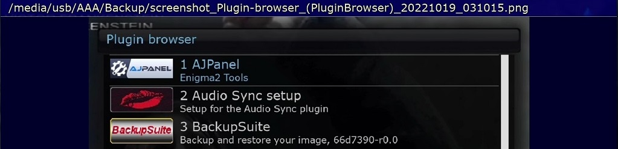
AJPanel OSD-Screenshot File Name
Path
Skin Title
Skin Name
Date
Time

Slide 3
